Slide 1
NoSQL Database Management Systems
Amos Azaria

Slide 2
NoSQL
No SQL, also known as 'not only SQL', refers in general to database management systems that do not rely on the relational (table) data storage.
Usually avoid joins and have a more relaxed definition of consistency.
More flexible (usually attributes can be added on the fly).
Support big data!

Slide 3
Why use NoSQL?
Scalability!
Too much data storage for allowing a single controller.
Structure may change over time.

Slide 4
What is the Price-tag? (i.e. What Do We Give-up?)
Limited query capabilities (usually avoiding joins.)
Usually can't ensure all ACID (Atomicity, Consistency, Isolation, and Durability).
Usually support BASE (Basically Available, soft State, eventual consistency).
(Not standardized.)

Slide 5
From ACID to BASE
Basically Available: data is mostly available.
soft State: state may change even with no updates (since older updates are still propagating).
Eventual consistency: if we let the data propagate enough time, it will become consistent.

Slide 6
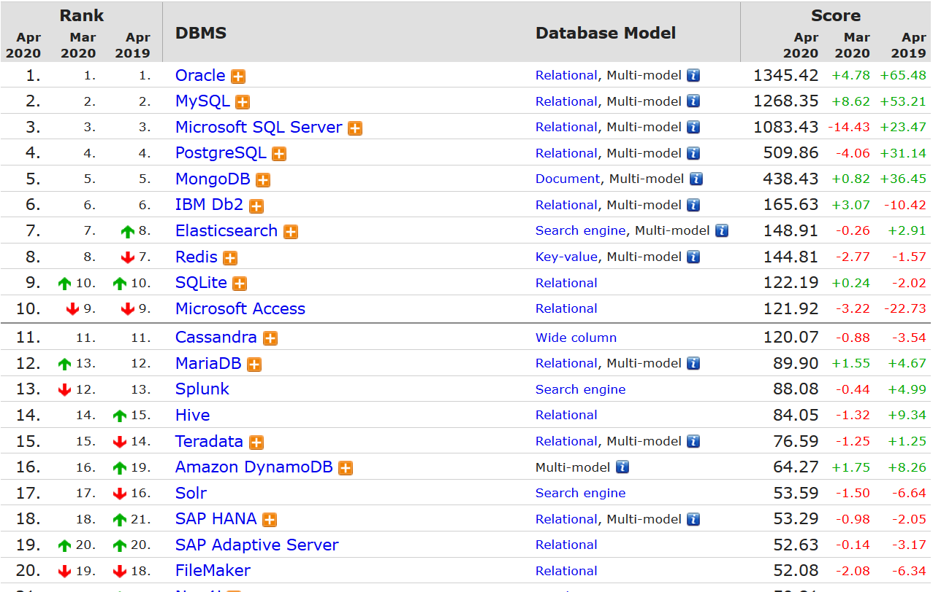
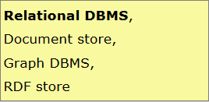
Database management system usage (http://db-engines.com/en/ranking)
The leading RDBMS have started to add support for additional models

Slide 7
CAP theorem
It is impossible for a distributed computer system to simultaneously provide more than two out of three of the following guarantees:
Consistency: Every read receives either the most recent written value or an error.
Availability: Every request receives a response (not necessarily the most recent value).
Partition tolerance: The system continues to operate despite an arbitrary number of messages being dropped (or delayed) by the network between nodes.

Slide 8
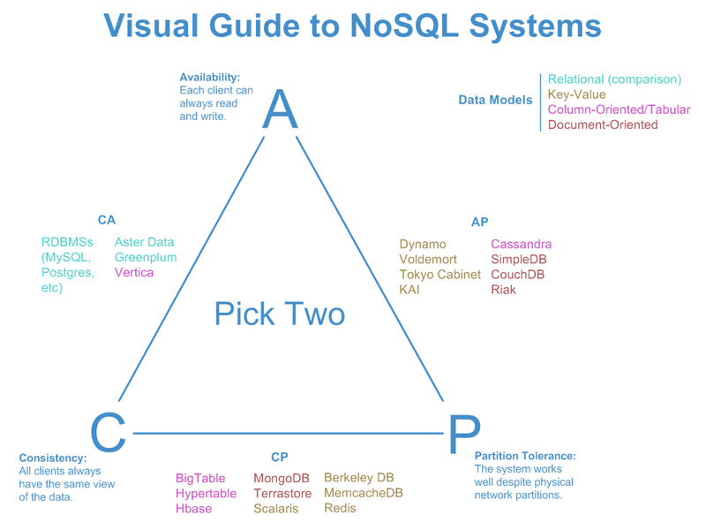
Credit: http://blog.nahurst.com/visual-guide-to-nosql-systems

Slide 9
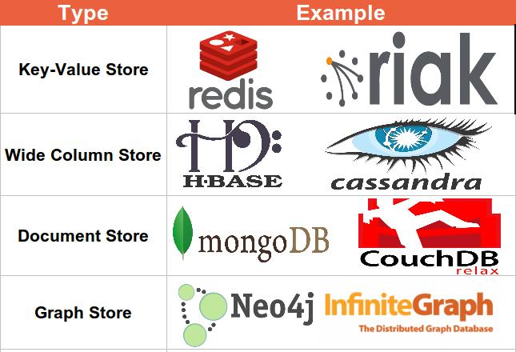



NoSQL database types:
For each of the types we will go into details and learn how to operate the leading database of that type!
http://www.algoworks.com/blog/nosql-database/
RDF
Search-Engine DB

Slide 10

Key-Value Store
Every item in the database is stored as an attribute name (or "key") together with its value.
No further structure is imposed (values are opaque).
Usually can only query by key (no features related to any structure are available).
Our example: Redis (next slides). You can try it online at: https://try.redis.io/. Case insensitive.

Slide 11
SET, GET, DEL
SET hello "world"
OK
GET hello
"world"
GET "world"
(nil)
SET name1 Yossi
GET name1
"Yossi"
SET user:1001 "<user><first_name>Joel</first_name> <last_name>Cohen</last_name></user>"
GET user:1001
"<user><first_name>Joel</first_name><last_name>Cohen</last_name></user>"
DEL user:1001
The value can be anything (e.g. XML)
We usually store the id as part of the key, so we can fetch it easily

Slide 12
INCR and INCRBY
SET bottles 5
INCR bottles
(integer) 6
INCRBY bottles -3
(integer) 3
INCR name1
(error) ERR value is not an integer or out of range
INCR x is equivalent to x++ (in JAVA), and is guaranteed to be atomic
INCRBY x y is equivalent to x+=y (in JAVA).

Slide 13
Lists (RPUSH, LPUSH, LRANGE)
RPUSH (Right Push) puts the new item last (on the very right)
RPUSH user:571:items "chair"
RPUSH user:571:items "table"
RPUSH user:571:items "water"
LPUSH user:571:items "cup"
LRANGE user:571:items 1 2
1) "chair" 2) "table"
LRANGE user:571:items 0 -1
1) "cup" 2) "chair" 3) "table" 4) "water"
RPUSH user:573:items "bed" "chair" "table" "can"
LPUSH (Left Push) puts the new item first (on the very left)
LRANGE key x y
Returns items from x to y
-1 means until the end of the list
You can provide the full list in a single command

Slide 14
Hashes(HSET, HGET, HMSET, HGETALL)
HSET user:302 first_name "Tamar"
HSET user:302 last_name "Cohen"
HGET user:302 first_name
"Tamar"
HMSET user:302 degree 3 gender "female"
HGET user:302 degree
"3"
HGETALL user:302
1) "first_name" 2) "Tamar" 3) "last_name" 4) "Cohen" 5) "degree" 6) "3" 7) "gender" 8) "female"
HMSET: for setting multiple attributes in a single command
It looks as if HGETALL returns a list, but it really returns a set

Slide 15
Get KEYS with pattern
SET user:1000 "Adam"
SET user:1001 "Tammy"
SET user:1002 "EVE"
SET user:1010 "APPLE"
RPUSH user:1003:items "chair"
KEYS user:100?
1) "user:1000" 2) "user:1001" 3) "user:1002"
KEYS user:*
1) "user:1000" 2) "user:1010" 3) "user:1003:items" 4) "user:1001" 5) "user:1002"

Slide 16
Sets and Sorted Sets
Redis also supports sets:
SADD x y (add item y to set x)
SREM x y (remove item y from set x)
SISMEMBER x y (is y a member of x)
SUNIOUN x q (returns the union of sets x and q)
And Sorted sets:
ZADD x val y (add item y with score val to sorted set x)
ZRANGE x y z (return z items from x, starting at y)

Slide 17
EXPIRE
The EXPIRE commands sets a time in seconds to which a value will expire.
EXPIRE user:302 100
TTL user:302
(integer) 92

Slide 18

Wide-Column Store
Every key identifies a row of a variable number of elements.
Have a strict format: Each key may be one level (or maybe two level) dictionaries. (Not any XML.)
Therefore, it can be seen as if it stores data together as tables, but the names and format of the columns can vary.
Our example: Cassandra
Notes:
In Cassandra (CQL), one can't add an entry with a new row without altering the table first (just like relational databases!) however, the difference is in the underlying representation, adding multiple columns will not increase data-storage and harm performance in Cassandra as it would in a relational database.

Slide 19

Cassandra
Used by: Facebook, Twitter, Cisco, Rackspace, eBay, Netflix
Cassandra Query Language (CQL), seems like a simple version of SQL:
No Joins.
No nested queries (can be done in code).
Case insensitive.
Download from: https://academy.datastax.com/planet-cassandra//cassandra and install
(If the service isn't running you can execute ….\bin\cassandra.bat)
…\bin\cqlsh.bat opens the client
In Greek mythology, Cassandra was a prophet and the princess of Troy.
Notes:
http://cassandra.apache.org/download/ and unzip

Slide 20
RMDB Habits
RMDB: Minimize the Number of Writes
Cassandra: Writes in Cassandra are awfully cheap. Cassandra is optimized for high write throughput, and almost all writes are equally efficient. If you can perform extra writes to improve the efficiency of your read queries, it’s almost always a good tradeoff. Reads tend to be more expensive and are much more difficult to tune.
RMDB: Minimize Data Duplication
Cassandra: Denormalization and duplication of data is a fact of life with Cassandra. In order to get the most efficient reads, you often need to duplicate data. The queries define the tables, so you might create tables duplicating some data in order to address different queries.

Slide 21
Creating a Keyspace (database)
Replication refers to how the data is replicated across different nodes
JSON style
CREATE KEYSPACE university WITH REPLICATION = {'class':'SimpleStrategy', 'replication_factor':2};
USE university;
CREATE TABLE students (id INT PRIMARY KEY, firstName VARCHAR, lastName VARCHAR, age INT);
SimpleStrategy: Use for a single data center only. NetworkTopologyStrategy: Can expand to multiple data centers.
Number of replicas of data on multiple nodes
Like SQL. But there is no need to specify the size for VARCHAR.

Slide 22
INSERT and SELECT
Exactly like SQL…
INSERT INTO students (id, firstName, lastName, age) VALUES (111, 'Chaya', 'Glass', 21);
INSERT INTO students (id, firstName) values (222, 'Only First');
SELECT * from students
id | age | firstname | lastname
-----+------+------------+----------
111 | 21 | Chaya | Glass
222 | null | Only First | null
Must use single quotes!

Slide 23
WHERE
WHERE on a key is ok
SELECT * from students WHERE id=111;
id | age | firstname | lastname
-----+-----+-----------+----------
111 | 21 | Chaya | Glass
SELECT * from students WHERE lastname='Glass';
InvalidRequest: Error from server: code=2200 [Invalid query] message="Cannot execute this query as it might involve data filtering and thus may have unpredictable performance. If you want to execute this query despite the performance unpredictability, use ALLOW FILTERING"
SELECT * from students where lastname = 'Glass' ALLOW FILTERING;
This works…
SELECT * from students WHERE id > 100;
InvalidRequest: Error from server: code=2200 [Invalid query] message="Only EQ and IN relation are supported on the partition key (unless you use the token() function)"
WHERE on a non-key attribute…
WHERE on a key but an inequality

Slide 24
Advanced Querying
Multiple primary keys (composite key), note the order
CREATE TABLE grades (studentId INT, course TEXT, grade FLOAT, PRIMARY KEY(studentId, course));
INSERT INTO grades(studentId, course, grade) values(111, 'into to intro', 95);
INSERT INTO grades(studentId, course, grade) values(111, 'calculus', 78);
INSERT INTO grades(studentId, course, grade) values(111, 'Algebra', 81);
INSERT INTO grades(studentId, course, grade) values(222, 'Algebra', 51);
INSERT INTO grades(studentId, course, grade) values(222, 'Algebra', 61);
SELECT * from grades;
studentid | course | grade
-----------+---------------+-------
111 | Algebra | 81
111 | calculus | 78
111 | into to intro | 95
222 | Algebra | 61
SELECT grade from grades WHERE studentid=111;
grade
-------
81
78
95
SELECT grade from grades WHERE studentid=111 AND course > 'b';
grade
-------
78
95
Partition Key
Clustering key
This row is actually an update!
(CQL supports update as well)
No need to provide all primary keys
If the partition key (the first primary key) is provided, it is ok to have inequality conditions only on the last clustering key provided.
Notes:
Cassandra has an "UPDATE" statement, but aside of counter support, UPDATE and INSERT are identical.

Slide 25
Illegal Queries (Require ALLOW_FILTERING)
SELECT grade FROM grades WHERE course > 'b';
SELECT grade FROM grades where course='Algebra';
SELECT grade FROM grades WHERE grade > 70;
SELECT grade FROM grades WHERE studentid=111 AND grade > 70;
Keys must be provided by order!
All these limitations/constrains are derived from the way Cassandra stores (and sorts) the data.
Think of the keys as a path in a file system. You must specify the whole path until the directory you are querying.

Slide 26
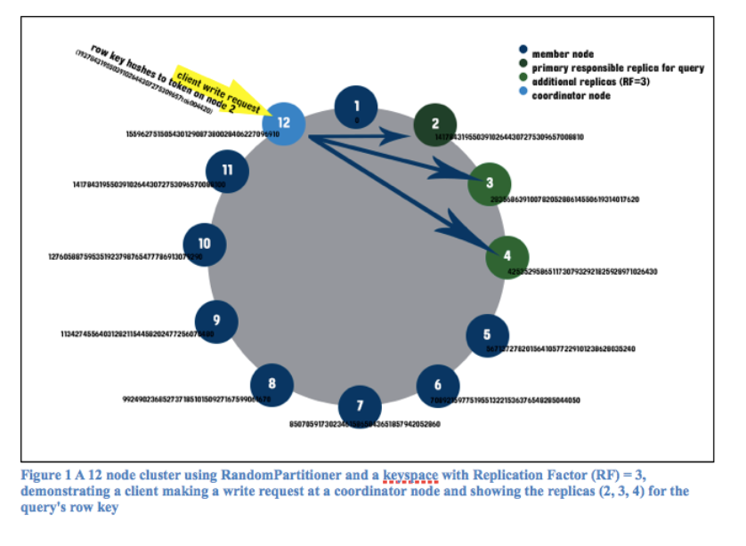
Cassandra's storage method
Cassandra stores the data as multimaps.
Therefore we need to give all the keys in order, so we get to the correct map.
Data is stored on sequential nodes using a ring model.
The coordinator node returns the nodes that hold all the replications of the data.
https://www.hakkalabs.co/articles/how-cassandra-stores-data
Notes:
The coordinator node returns the nodes that hold all the replications of the data.
Data is stored on sequential nodes using a ring model.

Slide 27


Order of Keys (partition and clustering)
Table T with Primary keys:
x as the partition key and y, z as clustering keys
SELECT * FROM T WHERE x = 5;
SELECT * FROM T WHERE y = 5;
SELECT * FROM T WHERE x = 5 AND z = 7;
SELECT * FROM T WHERE x = 5 AND y < 3 AND z > 0;
SELECT * FROM T WHERE x = 5 AND y < 6 AND y > 0;
SELECT * FROM T WHERE x = 5 AND z = 4 AND y > 0;
SELECT * FROM T WHERE x < 10;
SELECT * FROM T WHERE x =2 AND z <4 AND y = 3;
SELECT * FROM T WHERE y = 2 AND z < 8;

Slide 28
Partition Key
The partition key can include more than a single key.
When data is inserted into the cluster, the first step is to apply a hash function to the partition key. The output is used to determine what node (and replicas) will get the data.
The whole partition key must be specified (with equality sign) every query! (unless we request the whole table)
This is because Cassandra must know where to find the requested data.
E.g. CREATE TABLE grades (studentId INT, course TEXT, grade FLOAT, passed BIT, PRIMARY KEY((studentId, course), grade));
SELECT * FROM grades WHERE studentId=111 AND course=20
SELECT * FROM grades WHERE studentId=11

Slide 29

Document Store
Each key is paired with a document (a complex data structure). Documents can contain many different key-value pairs, or key-array pairs, or even nested documents.
These documents are usually written in XML or JSON.
Unlike in the key-value store, the database has some level of "understanding" of these documents.
Our example: MongoDB

Slide 30
MongoDB
Python, C++, JavaScript, JAVA and C# interfaces.
Most widely used NoSQL database.
Case sensitive!
Syntax uses JavaScript (heavily use of JSON).
Download from: https://www.mongodb.com/download-center
Server:
.…\bin\mongod.exe --dbpath c:\temp\mongodata
Client:
….\bin\mongo.exe
Or download Robomongo for a GUI.

Slide 31
use and db.dropDatabase()
use mydb will switch to mydb and create it if it doesn't already exist.
use University
switched to db University
db.dropDatabase()
{ "ok" : 1 }

Slide 32
db.createCollection(name, options)
Tables are called collections in MongoDB.
Collections are created automatically, but you can create a collection to set specific parameters.
db.createCollection("students", { capped : true, size : 6142800, max : 10000, autoIndexID : true } )
db.students.drop()
circular collection (if there is no room, oldest document is deleted)
size in bytes
max documents
Automatically create an id. (true is default)
Delete collection

Slide 33
db.collection.insert(document)
db.students.insert({"FirstName": "Chaya",
"LastName": "Glass",
"id": "111",
"age": "21",
"Address": {
"Street": "Hatamr 5",
"City": "Ariel",
"Zip": "40792"}
})
db.students.insert([{"FirstName": "Tom", "LastName": "Glow", "Address": {"Street": "Mishmar 5","City": "Ariel"}}, {"FirstName": "Tal", "LastName": "Negev", "Address": {"Street": "Yarkon 26","City": "Jerusalem"}}])
JSON format
Inserting multiple document using a list

Slide 34
db.collection.find()
db.students.find()
{ "_id" : ObjectId("589afa8c44a5653a862dd692"), "FirstName" : "Chaya", "LastName" : "Glass", "id" : "111", "age" : "21", "Address" : { "Street" : "Hatamr 5", "City" : "Ariel", "Zip" : "40792" } }
{ "_id" : ObjectId("589afa9244a5653a862dd693"), "FirstName" : "Tom", "LastName": "Glow", "Address" : { "Street" : "Mishmar 5", "City" : "Ariel" } }
{ "_id" : ObjectId("589afa9244a5653a862dd694"), "FirstName" : "Tal", "LastName": "Negev", "Address" : { "Street" : "Yarkon 26", "City" : "Jerusalem" } }
db.students.find().pretty()
db.students.find({"FirstName": "Tal"})
{ "_id" : ObjectId("589afa9244a5653a862dd694"), "FirstName" : "Tal", "LastName"
: "Negev", "Address" : { "Street" : "Yarkon 26", "City" : "Jerusalem" } }
db.students.find({"Address.City": "Ariel"})
{ "_id" : ObjectId("589afa8c44a5653a862dd692"), "FirstName" : "Chaya", "LastName" : "Glass", "id" : "111", "age" : "21", "Address" : { "Street" : "Hatamr 5", "City" : "Ariel", "Zip" : "40792" } }
{ "_id" : ObjectId("589afa9244a5653a862dd693"), "FirstName" : "Tom", "LastName": "Glow", "Address" : { "Street" : "Mishmar 5", "City" : "Ariel" } }
Note the automatic ids
{
"_id" : ObjectId("589af41d44a5653a862dd68d"),
"Student" : {
"FirstName" : "Chaya",
"LastName" : "Glass",
"id" : "111",
"age" : "21",
"Address" : {
"Street" : "Hatamr 5",
"City" : "Ariel",
"Zip" : "40792"
}
}
}
{
"_id" : ObjectId("589af4a844a5653a862dd68e"),
…

Slide 35
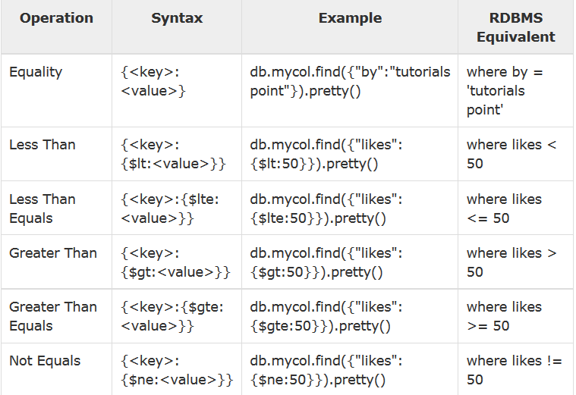
Inequalities in MongoDB (Slide is provided just for completeness)
Credit: https://www.tutorialspoint.com/mongodb/mongodb_query_document.htm

Slide 36
and, or
Note the list.
db.students.find({$and: [{"FirstName": "Tal"},{"LastName":"Negev"}]})
{ "_id" : ObjectId("589afa9244a5653a862dd694"), "FirstName" : "Tal", "LastName": "Negev", "Address" : { "Street" : "Yarkon 26", "City" : "Jerusalem" } }
db.students.find({"FirstName": "Tal","LastName":"Negev"})
db.students.find({"FirstName":"Tom", $or: [{"LastName":"Negev"},{"LastName":"Glow"}]})
{ "_id" : ObjectId("589afa9244a5653a862dd693"), "FirstName" : "Tom", "LastName"
: "Glow", "Address" : { "Street" : "Mishmar 5", "City" : "Ariel" } }
Equivalent to above.
Note that in all these examples we always gave find only a single parameter.

Slide 37
Select Specific Fields (Projection in Relational Algebra)
db.students.find({"FirstName":"Tim"},{"FirstName":true})
{ "_id" : ObjectId("589afa9244a5653a862dd693"), "FirstName" : "Tim" }
db.students.find({"FirstName":"Tim"},{"FirstName":true, _id:false})
{ "FirstName" : "Tim" }
db.students.find({},{"FirstName":true, _id:false})
{ "FirstName" : "Chaya" }
{ "FirstName" : "Tim" }
{ "FirstName" : "Tal" }
Id is displayed even when not requested explicitly
RDBMS: SELECT FirstName FROM students

Slide 38
update, set
db.students.update({"FirstName":"Tom"}, {"FirstName" : "Tim", "LastName": "Glow", "Address" : { "Street" : "Mishmar 5", "City" : "Ariel" }})
db.students.update({"FirstName":"Tom"}, {$set:{"FirstName":"Tim"}},{multi:true})
MongoDB will search for a FirstName="Tom", and change the whole document to be: {"FirstName" : "Tim", "LastName": "Glow", "Address" : { "Street" : "Mishmar 5", "City" : "Ariel" }})
Set will leave all other fields unchanged.
If we don't set multi to true, MongoDB will only set the first item it finds

Slide 39
Map-Reduce Paradigm
A set of algorithms allowing parallel execution on massive amounts of data.
Mapper: splits data, filters and runs a process.
Shuffle and Sort / Grouping: ensures that all worker nodes have all data required for reduce.
Reduce: worker nodes process each group of output data and build the output.
We will come back to this paradigm when we learn Spark.

Slide 40
Map-Reduce Example
Find the minimum and maximum of grades according to student age:
Map: every grade is mapped to an age.
Grouping: grades are divided into datasets (possibly) sorted by age such that every worker gets an age-group.
Reduce: every worker finds the minimum and maximum for every age in its dataset.
[Finally, if one group is split among more than single reducer: the minimum amongst the minimums and the maximum amongst the maximums is the final result.]

Slide 41
mapReduce()
Suppose we have documents with the following structure:
{
_id: ObjectId("50a8240b927d5d8b5891743c"),
cust_id: "abc123",
ord_date: new Date("Oct 04, 2012"),
status: 'A',
amount: 25,
items: [ { sku: "mmm", qty: 5, price: 2.5 },
{ sku: "nnn", qty: 5, price: 2.5 } ]
}
We would like to get the total amount paid by each cust_id with status 'A'.
Can we do this in a relational DB, With SQL?
SKU = Stock Keeping Unit is an item identifier.
We will need to assume a different structure in a relational data-base.
Following slides are based on mongodb docs.

Slide 42
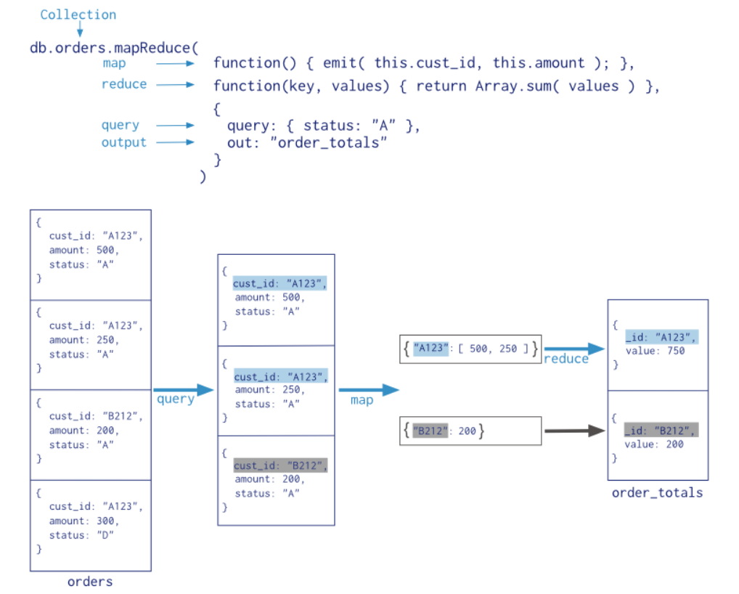
mapReduce() (cont.)
This is actually map + shuffle
Credit: https://docs.mongodb.com/manual/core/map-reduce/
Notes:
Quuery is actually a part of the map (which also performs filter).

Slide 43
Results
db.order_totals.find()
{ "_id" : "abc123", "value" : 50 }
{ "_id" : "def123", "value" : 75 }
{ "_id" : "ghi123", "value" : 25 }
Notes:
ככה נשלוף בשביל לראות את התוצאה.
התוצאות לא קשורות לנתונים שראינו קודם, הכנסתי נתונים אחרים
זה בעיקר בשביל לראות איך זה נראה ומה צריך לעשות בשביל לראות אותם

Slide 44
A more complex example of mapReduce
We would now like to get for each item identifier (SKU) the following:
1. how many items were sold,
2. the average quantity sold for that SKU,
ignoring all items sold before 1/1/2012.
E.g.:
[{ sku: "mmm", total: 5543, avg: 5.4 },
{ sku: "nnn", total: 1253, avg: 3.6 },
{ sku: "a453", total: 53, avg: 1.1 }]

Slide 45
Answer
db.orders.mapReduce(
mapFunction2,
reduceFunction2,
{
out: { merge: "sku_info" },
query: { ord_date: { $gt: new Date('01/01/2012') } },
finalize: finalizeAddAvgField
}
)
Will be defined in next slides
merge means that if "sku_info" exists, we append to it.
Defined later

Slide 46
map Function
The map function will go over each document that meets the queries filter, and output the SKUs as keys and the quantities as outputs.
var mapFunction2 = function() {
for (var idx = 0; idx < this.items.length; idx++) {
var key = this.items[idx].sku;
var value = {
count: 1,
qty: this.items[idx].qty };
emit(key, value);
} };
We also output count:1, this will help us with calculating the average.

Slide 47
reduce
The reduce function will go over the SKUs and lists from the map and add up the quantities and counters:
var reduceFunction2 =
function(keySKU, countObjVals) {
reducedVal = { count: 0, qty: 0 };
for (var idx = 0; idx < countObjVals.length; idx++) {
reducedVal.count += countObjVals[idx].count;
reducedVal.qty += countObjVals[idx].qty;
}
return reducedVal;
};

Slide 48
finalize
The finalize function will go over the reduce's output and calculate the average:
var finalizeAddAvgField =
function (key, reducedVal) {
reducedVal.avg = reducedVal.qty/reducedVal.count;
return reducedVal;
};

Slide 49
Results
db.sku_info.find()
{ "_id" : "ccc", "value" : { "count" : 1, "qty" : 5, "avg" : 5 } }
{ "_id" : "mmm", "value" : { "count" : 5, "qty" : 25, "avg" : 5 } }
{ "_id" : "nnn", "value" : { "count" : 4, "qty" : 20, "avg" : 5 } }
{ "_id" : "rrr", "value" : { "count" : 1, "qty" : 5, "avg" : 5 } }
{ "_id" : "uuu", "value" : { "count" : 1, "qty" : 5, "avg" : 5 } }

Slide 50
show
show University
show dbs
show collections

Slide 51
Search Engine Databases
Search engine databases are a sub-type of document stores.
Scoring or relevance of documents plays a deep role, something that we hadn't seen before in relational DB or other NoSQL DBs.
Our example: Elastic Search

Slide 52
Elastic Search
Used in: Wikipedia, StackOverflow, GitHub, The Guardian and more.
RESTful and Java API.
Case sensitive (even in url).
Builds upon Lucene.
Near Real Time
Download from: https://www.elastic.co/downloads/elasticsearch and unzip (or use apt in Linux).
Run …\bin\elasticsearch.bat
We will use curl for HTTP commands: basically GET, POST, PUT, HEAD and DELETE. [Better use other user interfaces (e.g. fiddler2).]
It takes approximately 1 second from the time a document is added or edited until it can be searched (compare this with the time it takes Google to index new pages).

Slide 53
Adding Documents (items)
There is no need to create an Index (Database) or a Type (a table), we can right away insert a document using:
curl -XPUT "http://localhost:9200/university/students/111" -d "{\"FirstName\": \"Chaya\", \"LastName\": \"Glass\", \"age\": \"21\", \"Address\": { \"Street\": \"Hatamr 5\", \"City\": \"Ariel\",\"Zip\": \"40792\"}}"
curl -XPUT "http://localhost:9200/university/students/333" -d "{\"FirstName\": \"Gadi\", \"LastName\": \"Golan\", \"age\": \"24\"}"
curl -XPOST "http://localhost:9200/university/students" -d "{\"FirstName\": \"Tal\", \"LastName\": \"Negev\", \"age\": \"28\"}"
POST without id, will generate id automatically
Generally, in REST API, PUT is idempotent (n{msg} = {msg}), and POST isn't. (What will happen if we send each of the above messages twice?)
Notes:
We could create an index and apply some constrains on the types and objects that can be stored in documents in this index.

Slide 54
GET, HEAD, DELETE
curl -XGET "http://localhost:9200/university/students/333"
{"_index":"university","_type":"students","_id":"333","_version":1,"found":true, "_source":{"FirstName": "Gadi", "LastName": "Golan", "age": "24"}}
HEAD only tests if document exists. (replace XGET with XHEAD in the command above).
DELETE deletes the document
Note all the metadata.

Slide 55
Search (SELECT)
curl –XGET "http://localhost:9200/university/students/_search"
{"took":5,"timed_out":false,"_shards":{"total":5,"successful":5,"failed":0},"hits":{"total":3,"max_score":1.0,"hits":[{"_index":"university","_type":"students","_id":"222","_score":1.0,"_source":{"FirstName": "Tal", "LastName":"Negev", "age":"28"}},{"_index":"university","_type":"students","_id":"333","_score":1.0,"_source":{"FirstName": "Gadi", "LastName": "Golan", "age": "24"}},{"_index":"university","_type":"students","_id":"111","_score":1.0,"_source":{"FirstName": "Chaya", "LastName": "Glass", "age": "21", "Address": { "Street": "Hatamr 5", "City": "Ariel","Zip": "40792"}}}]}}
curl -XGET "http://localhost:9200/university/students/_search? q=LastName:Negev"
{"took":21,"timed_out":false,"_shards":{"total":5,"successful":5,"failed":0},"hits":{"total":1,"max_score":0.2876821,"hits":[{"_index":"university","_type":"students","_id":"222","_score":0.2876821,"_source":{"FirstName": "Tal", "LastName": "Negev", "age": "28"}}]}}
SELECT * FROM students WHERE LastName='Negev'
Notes:
We can remove LastName, elasticsearch will look for Negev in all fields.

Slide 56
Advanced Search (bool query)
curl -XGET "http://localhost:9200/university/students/_search" -d"
{ \"query\" :
{ \"bool\" :
{ \"filter\" :
{ \"match\" :
{ \"Address.City\" : \"Ariel\" } },
\"filter\" :
{ \"range\" :
{ \"age\" :
{ \"lt\" : 30 } } } } } } "
Boolean combination of other queries.
All students living in Ariel
{"took":6,"timed_out":false,"_shards":{"total":5,"successful":5,"failed":0},"hit
s":{"total":1,"max_score":0.0,"hits":[{"_index":"university","_type":"students",
"_id":"111","_score":0.0,"_source":{"FirstName": "Chaya", "LastName": "Glass", "
age": "21", "Address": { "Street": "Hatamr 5", "City": "Ariel","Zip": "40792"}}}
]}}
Students under 30

Slide 57
Scoring: Relevance
Elasticsearch returns the documents with the highest score.
As seen, when querying with "filter" no score is aggregated. ("must_not" doesn't have a score either).
Elasticsearch supports also "must" and "should". Both influence the score.
"must" and "should" can also appear inside a "filter", in which case "must" is a logical "AND", while "should" is a logical "OR".
Scoring becomes interesting when we start matching strings.
Elasticsearch uses a bag of words TF-IDF model (will discuss later on).
Notes:
Must has to appear, but should does not have to appear unless there is no must clause, and then at least one should must appear.

Slide 58
String Queries
Let's first add some descriptions to the students' documents, using _update:
curl -XPOST http://localhost:9200/university/students/111/_update -d "{ \"script\" : \"ctx._source.description = \\\"Likes learning but gets board very quickly. Doesn't enjoy trips that much.\\\"\" }"
curl -XPOST http://localhost:9200/university/students/222/_update -d "{ \"script\" : \"ctx._source.description = \\\"Doesn't show-up to lessons, but is very smart and learns a lot.\\\"\" }"
curl -XPOST http://localhost:9200/university/students/AVohwsYTVPDjS737L8vs/_update -d "{ \"script\" : \"ctx._source.description = \\\"Doesn't know anything. Goes on trips all day, never showed-up to a single lesson.\\\"\" }"

Slide 59
String Queries (cont.)
curl -XGET http://localhost:9200/university/students/_search -d "{ \"query\" : { \"match\" : { \"description\" : \"doesn't show-up learns\" } }}
{"took":8,"timed_out":false,"_shards":{"total":5,"successful":5,"failed":0},"hits":{"total":3,"max_score":1.0514642,"hits":[
{"_index":"university","_type":"students","_id":"222","_score":1.0514642,"_source":{"FirstName":"Tal","LastName":"Negev","age":"28","description":"Doesn't show-up to lessons, but is very smart and learns a lot."}},
{"_index":"university","_type":"students","_id":"AVohwsYTVPDjS737L8vs","_score":0.56008905,"_source":{"FirstName":"Gadi","LastName":"Golan","age":"24","description": "Doesn't know anything. Goes on trips all day, never showed-up to a single lesson."}},
{"_index":"university","_type":"students","_id":"111","_score":0.25316024,"_source":{"FirstName":"Chaya","LastName":"Glass","age":"21","Address":{"Street":"Hatamr 5","City":"Ariel","Zip":"40792"},"description":"Likes learning but gets board very quickly. Doesn't enjoy trips that much."}}]}}
curl -XGET http://localhost:9200/university/students/_search -d "{ \"query\" : { \"match\" : { \"description\" : \"doesn't show-up learns\" } },
\"highlight\": { \"fields\" : { \"description\" : {} } }
}
The underlined words, can be highlighted automatically, using the "highlight" option!

Slide 60
Exact Phrase (Like " " in Google)
If we want the exact phrase, we can use "match_phrase" instead of "match".
We can also mix "match" and "match_phrase".
If we use a query URI, we can just add " ", e.g.:
curl -XGET "http://localhost:9200/university/students/_search? q=description:\"works hard\""

Slide 61
Information Retrieval (TF-IDF) Document Ranking
Suppose we have a query (Q) and many possible documents (D={d1,d2…}). How can we rank these documents based on the query?

Slide 62
Document Ranking Example
Q: Who is the president of the united states?
D1: Donald Trump is United States’ president.
D2: We are the most united out of all the people and of all the places.
D3: The United States of America is united again, who is more united than it?
D4: Who would like to take the box out of the kitchen?

Slide 63
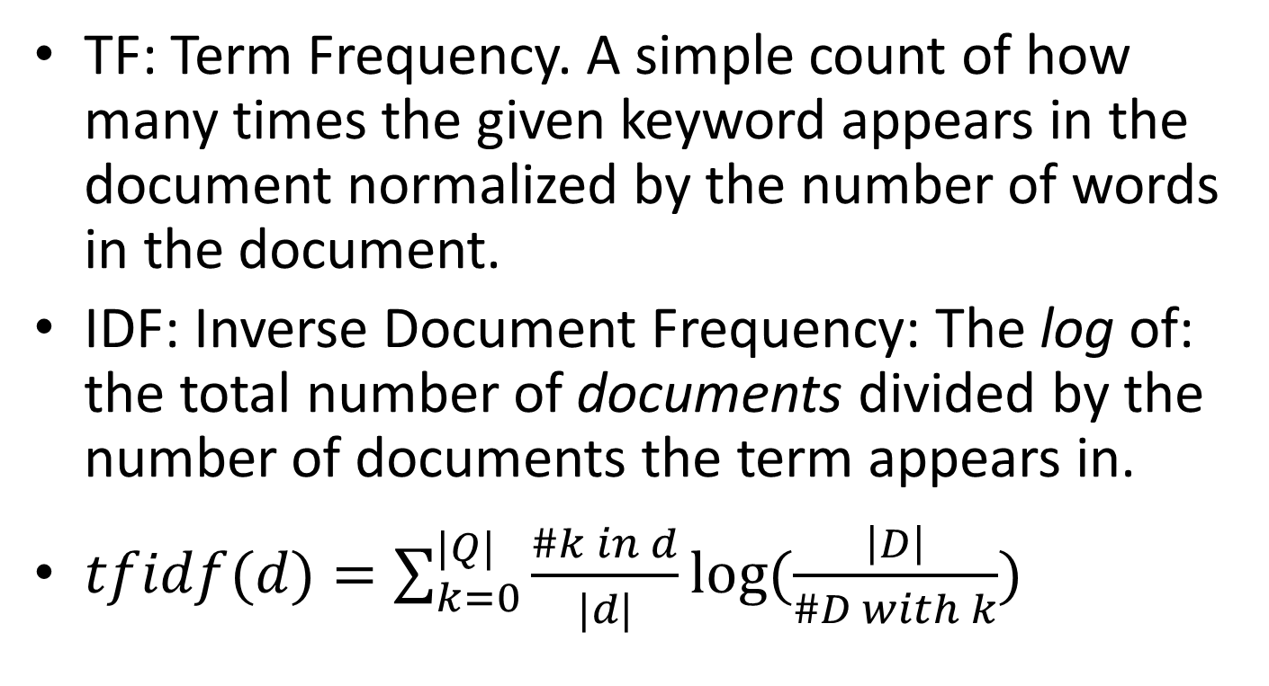
Tf-Idf
TF: Term Frequency. A simple count of how many times the given keyword appears in the document normalized by the number of words in the document.
IDF: Inverse Document Frequency: The log of: the total number of documents divided by the number of documents the term appears in.
$tfidf(d)=\sum_{k=0}^{|Q|}{\frac{\#k in d}{|d|}log⁡(\frac{\left|D\right|}{\#D with k})}$
d: current document
D: full corpus (of documents)
k: word in document/query
Q: set of words in query
TF
IDF
Notes:
There are different measurements for tf-idf, this is the most common one.

Slide 64

Document Ranking
 | Who | Is | The | President | Of | United | States | #words
D1 | 0 | 1 | 0 | 1 | 0 | 1 | 1 | 6
D2 | 0 | 0 | 3 | 0 | 2 | 1 | 0 | 15
D3 | 1 | 1 | 1 | 0 | 1 | 3 | 1 | 14
D4 | 1 | 0 | 2 | 0 | 1 | 0 | 0 | 11
#Doc | 2 | 2 | 3 | 1 | 3 | 3 | 2
$$tfidf(d)=\sum_{k=0}^{|Q|}{\frac{\#k in d}{|d|}log⁡(\frac{\left|D\right|}{\#D with k})}$$
Q: Who is the president of the united states?
D1: Donald Trump is United States’ president.
D2: We are the most united out of all the people and of all the places.
D3: The United States of America is united again, who is more united than it?
D4: Who would like to take the box out of the kitchen?
Doc | Tf-Idf score
D1 | (1/6)*log(4/2)+(1/6)*log(4/1)+(1/6)*log(4/3)+(1/6)*log(4/2)=0.736
D2 | (3/15)*log(4/3)+(2/15)*log(4/3)+(1/15)*log(4/3)=0.166
D3 | (1/14)*log(4/2)+(1/14)*log(4/2)+(1/14)*log(4/3)+(1/14)*log(4/3)+(3/14)*log(4/3)+(1/14)*log(4/2)=0.363
D4 | (log(4/2)+2*log(4/3)+log(4/3))/11=0.204

Slide 65
Graph Databases
Store information as graphs, with nodes and relations between the nodes.
Allow interesting queries such as, finding all the friends of a person, all their friends, and so on until 10 levels.

Slide 66
Resource Description Framework (RDF) graph databases
RDF is a standard model for data interchange on the Web.
RDF has features that facilitate data merging even if the underlying schemas differ.
RDF specifically supports the evolution of schemas over time without requiring all the data consumers to be changed.

Slide 67
RDF Triples
The dataset includes a list of triples of the form:
subject, predicate, object.
All data is presented only by these triples.
There is only a single "table", containing all these triples (a triple store).
Subject
Predicate
Object

Slide 68

Apache Jena
Download from: https://jena.apache.org/download/index.cgi
There is no need to actually install Jena, unless you intend to use it.
Jena uses URIs to identify all entities and relations.
We will focus on SPARQL which is the RDF query language.

Slide 69
ARQ / SPARQL
RDF query language is called SPARQL.
ARQ is an implementation of a SPARQL Processor for Jena.
All queries include a set of triples: subject, predicate, object.
We will only learn selection.
You can try SPARQL at: http://sparql-playground.sib.swiss/
[The queries and images in the following slides are taken from there.]

Slide 70
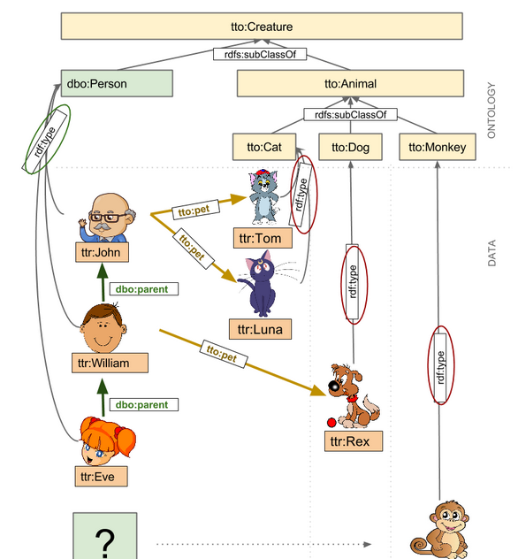
A Partial View of Our Database (Ontology + Data)

Slide 71
SELECT *
Why is there no "FROM" clause?
SELECT * WHERE {?s ?p ?o}
s | p | o
ttr:Eve | dbo:parent | ttr:William
ttr:Eve | dbp:birthDate | "2006-11-03"
ttr:Eve | dbp:name | "Eve"
ttr:Eve | tto:sex | "female"
ttr:Eve | rdf:type | dbo:Person
ttr:John | dbp:birthDate | "1942-02-02"
ttr:John | dbp:name | "John"
ttr:John | tto:pet | ttr:LunaCat
ttr:John | tto:pet | ttr:TomCat
ttr:John | tto:sex | "male"
ttr:John | rdf:type | dbo:Person
ttr:LunaCat | dbp:name | "Luna"
ttr:LunaCat | tto:color | "violet"
ttr:LunaCat | tto:sex | "female"
ttr:LunaCat | tto:weight | "4.2"
ttr:LunaCat | rdf:type | tto:Cat
ttr:RexDog | dbp:name | "Rex"
ttr:RexDog | tto:color | "brown"
ttr:RexDog | tto:sex | "male"
ttr:RexDog | tto:weight | "8.8"
ttr:RexDog | rdf:type | tto:Dog
ttr:SnuffMonkey | dbp:name | "Snuff"
ttr:SnuffMonkey | tto:color | "golden"
ttr:SnuffMonkey | tto:sex | "male"
ttr:SnuffMonkey | tto:weight | "3.6"
ttr:SnuffMonkey | rdf:type | tto:Monkey
ttr:TomCat | dbp:name | "Tom"
ttr:TomCat | tto:color | "grey"
ttr:TomCat | tto:sex | "male"
ttr:TomCat | tto:weight | "5.8"
ttr:TomCat | rdf:type | tto:Cat
ttr:William | dbo:parent | ttr:John
ttr:William | dbp:birthDate | "1978-07-20"
ttr:William | dbp:name | "William"
ttr:William | tto:pet | ttr:RexDog
ttr:William | tto:sex | "male"
ttr:William | rdf:type | dbo:Person
dbo:Person | rdfs:subClassOf | tto:Creature
tto:Animal | rdf:type | rdfs:Class
tto:Animal | rdfs:isDefinedBy | tto:
tto:Animal | rdfs:label | "animal"
tto:Animal | rdfs:subClassOf | tto:Creature
tto:Cat | rdf:type | rdfs:Class
tto:Cat | rdfs:isDefinedBy | tto:
tto:Cat | rdfs:label | "cat"
tto:Cat | rdfs:subClassOf | tto:Animal
tto:Creature | rdf:type | rdfs:Class
tto:Creature | rdfs:isDefinedBy | tto:
tto:Creature | rdfs:label | "creature"
tto:Dog | rdf:type | rdfs:Class
tto:Dog | rdfs:isDefinedBy | tto:
tto:Dog | rdfs:label | "dog"
tto:Dog | rdfs:subClassOf | tto:Animal
tto:Monkey | rdf:type | rdfs:Class
tto:Monkey | rdfs:isDefinedBy | tto:
tto:Monkey | rdfs:label | "monkey"
tto:Monkey | rdfs:subClassOf | tto:Animal
tto:pet | rdf:type | rdf:Property
tto:pet | rdfs:domain | dbo:Person
tto:pet | rdfs:isDefinedBy | tto:
tto:pet | rdfs:label | "domestic animal"
tto:pet | rdfs:range | tto:Animal
tto:sex | rdf:type | rdf:Property
tto:sex | rdfs:domain | tto:Creature
tto:sex | rdfs:isDefinedBy | tto:
tto:sex | rdfs:label | "sex"
tto:sex | rdfs:range | xsd:string
tto:weight | rdf:type | rdf:Property
tto:weight | rdfs:comment | "weight in kilograms"
tto:weight | rdfs:domain | tto:Creature
tto:weight | rdfs:isDefinedBy | tto:
tto:weight | rdfs:label | "weight"
tto:weight | rdfs:range | xsd:decimal

Slide 72
Select all Persons
SELECT ?something WHERE {?something rdf:type dbo:Person .}
something
ttr:Eve
ttr:John
ttr:William

Slide 73

Select all Women
SELECT ?thing WHERE {
?thing rdf:type dbo:Person .
?thing tto:sex "female" .
}
"rdf:type" can be replaced by "a"

Slide 74

Select Persons That Have Pets
SELECT ?person WHERE {
?person rdf:type dbo:Person .
?person tto:pet ?pet .
}
Why do we have two ttr:John?
We can add the "DISTINCT" keyword above to avoid this.

Slide 75
פה

Slide 76

Select Persons That Have Cats
SELECT DISTINCT ?person WHERE {
?person rdf:type dbo:Person .
?person tto:pet ?type .
?type rdf:type tto:Cat .
}

Slide 77

Select Persons That do not Have any Pets
SELECT ?person WHERE {
?person rdf:type dbo:Person .
FILTER NOT EXISTS {?person tto:pet ?pet } .
}

Slide 78
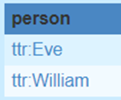
Select Persons That do not Have any Cats
SELECT ?person WHERE {
?person rdf:type dbo:Person .
FILTER NOT EXISTS {
?person tto:pet / rdf:type tto:Cat .}
}
/ Concatenates relations

Slide 79
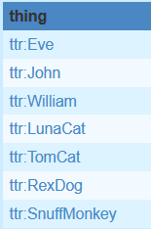
Select all Creatures (using UNION)
SELECT ?thing WHERE {
{
?thing a ?type .
{
?type rdfs:subClassOf tto:Creature .
} UNION
{
?type rdfs:subClassOf ?subcreature .
?subcreature rdfs:subClassOf tto:Creature .
}
}

Slide 80
Select all Creatures (simpler and more correct)
SELECT ?thing WHERE {
?thing a / rdfs:subClassOf+ tto:Creature .
}
+ is 1 or more of same predicate
(* is 0 or more)
(? Is 0 or 1)

Slide 81
General Graph Databases
Graph databases are not limited to RDF and SPARQL.
The more general graph databases allow more complex queries (not only triples).

Slide 82



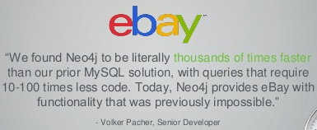
Neo4J
Name comes from "The Matrix".
Query Language called Cypher.
ACID (almost…)
Case insensitive.
Used by: ebay, Walmart, Cisco and many more…
Initially was only with Java interface (that's why it is 4J), but also has a REST API.
Can try without installing at:
http://console.neo4j.org/
Open source:
Community edition: GPL (for any use, but any modifications remain open-source)
Enterprise edition: AGPL (they claim that it is only for open source – but this seems like a false claim to me.)

Slide 83
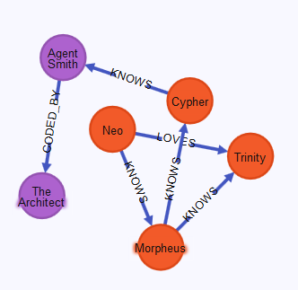
Graph Example
(Neo)-[:LOVES]->(Trinity)
(Neo)-[]->(Trinity)
(Architect)<-[:CODED_BY]-(Smith)
(Neo)-->(Trinity)
(Morpheus)-[:KNOWS]-(Trinity)
(Trinity)--(Neo)

Slide 84
CREATE
CREATE (n)
CREATE (glass:student {name: 'Chaya Glass', id:111, age:21, degree:'1'})
CREATE (:student {name: 'Tal Negev', id:222, age:28, degree:'3'}), (:student {name: 'Gadi Golan', id:333, age:24, degree:'1'})
Here student is a label. Labels act like categories or types.
The node reference ("glass") can only be used during the same query
Properties
Can use an empty reference
Can create many nodes at once

Slide 85
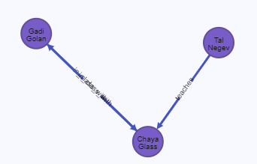
Adding Relations
When creating the graph and adding the nodes we can easily add relationships between the nodes, in the same CREATE statement using the node name.
CREATE (glass:student {name: 'Chaya Glass', id:111, age:21, degree:'1'}), (negev:student {name: 'Tal Negev', id:222, age:28, degree:'3'}), (golan:student {name: 'Gadi Golan', id:333, age:24, degree:'1'}), (negev)-[r1:teaches]->(glass), (golan)-[:in_class_with]->(glass), (glass)-[:in_class_with]->(golan)
All edges are directional. It is redundant to create the inverse relationship e.g.: (glass)-[:taught_by]->(negev).
Furthermore, also the 'in_class_with' relationship, could be defined only in one direction, and later ignore the direction when traversing the graph.

Slide 86
Adding Relations (cont.)
To add relations to nodes already present in the graph, we first need to find them:
MATCH (a:student),(b:student) WHERE a.name = 'Tal Negev' AND b.name = 'Chaya Glass' CREATE (a)-[r1:teaches]->(b)

Slide 87

Queries: MATCH (SELECT a node)
Find all nodes who have any relation with Chaya Glass
MATCH (a)-->(b{name:'Chaya Glass'}) RETURN a
Find all names of those who teach students:
MATCH (a)-[:teaches]->(b:student) RETURN a.name
Find all names of those who teach the student Chaya Glass:
MATCH (a)-[:teaches]->(b:student {name:'Chaya Glass'}) RETURN a.name

Slide 88
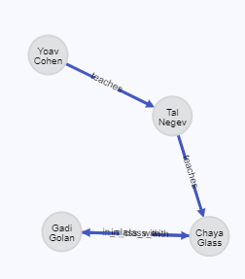

More Queries
Add some data:
CREATE (cohen:student {name: 'Yoav Cohen', id:666, age:21, degree: '1'})
MATCH (a:student),(b:student) WHERE a.name = 'Yoav Cohen' AND b.name = 'Tal Negev' CREATE (a)-[r1:teaches]->(b)
Find all names of those who teach the student Chaya Glass, or teach anyone who teaches the student Chaya Glass:
MATCH (a)-[:teaches*1..2]->(b:student {name:'Chaya Glass'}) RETURN a.name

Slide 89
Paths
MATCH p=(a {name:'Gadi Golan'})-[:KNOWS*2..4]->(b) RETURN p
Will return all paths of length 2 to 4 of type KNOWS, between Gadi Golan and others.
MATCH p=shortestPath((s1:student {name:'Gadi Golan'})-[*]-(s2:student {name:'Tal Negev'})) RETURN p
Will return the shortest path (using any type of relation, and in any direction) between Gadi Golan and Tal Negev (of type students).
… RETURN LENGTH(p)

Slide 90
WITH, ALL / ANY, IN, COLLECT, COUNT, AND, OR
MATCH (c:course) WITH COLLECT(c) AS courses MATCH (s:student) WHERE ALL (x IN courses WHERE (s)-[:studies]->(x)) RETURN s.name
Returns all students that study all courses.
MATCH (s:student)-[:studies]->(c:course) WITH s, COUNT(c) as num_courses WHERE num_courses <= 4 RETURN s.name
Returns all students that study at most 4 courses.
MATCH (negev { name:"Tal Negev" })-[:friend]->(frOfNegev:student)-[:knows]->(st:student) WITH frOfNegev, COUNT(st) AS frCount WHERE frCount > 3 RETURN frOfNegev
Returns all students that are Tal Negev's friend and know more than 3 students.
s must appear in WITH part, so we group by it and can return s.name
count() is an aggregate function. When using any aggregate function, result rows will be grouped by whatever is included in the WITH clause (not in the aggregate function).
Notes:
count() is an aggregate function. When using any aggregate function, result rows will be grouped by whatever is included in the WITH clause and not in aggregate function.
MIN
MAX

Slide 91
Additional query examples
Write a query that returns all the nodes that have any connectivity (of any length) with 'Tal Negev'
MATCH (a {name:'Tal Negev'})-[*]-(b) RETURN DISTINCT b
Write a query that returns all students that study all courses that 'Tal Negev' learns, but are under the age of 30.
MATCH (a {name:'Tal Negev'})-[:studies]->(c:course) WITH COLLECT(c) AS negev_courses MATCH (s:student) WHERE s.age < 30 AND ALL (x IN negev_courses WHERE (s)-[:studies]->(x)) RETURN s

Slide 92
OPTIONAL MATCH
Write a query that returns all the nodes that have any connectivity (of any length) with 'Tal Negev'
OPTIONAL MATCH works the same as MATCH except, that if one side of the MATCH isn't
The following will delete the whole database:
MATCH (n) OPTIONAL MATCH (n)-[r]-() DELETE n, r

